Slide 1

Exact String Matching
Exact String Matching Problem. Given a (long) string T and a shorter string P, find all occurrences of P in T. Occurrences of P are allowed to overlap.
Rabin-Karp
Algorithm

Slide 2

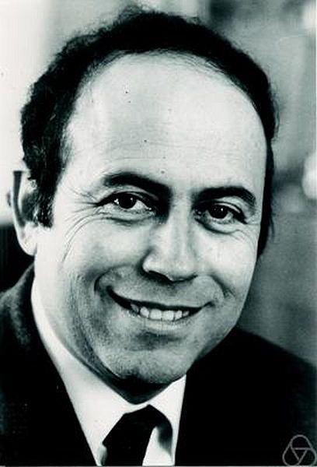
Rabin-Karp algorithm
Richard Manning Karp
Michael Oser Rabin

Slide 3
Rabin-Karp algorithm
Use a function T to that computes a numerical representation of P
Calculate T for all m symbol sequences of S and compare
P = ABA
S = BABABBABABA

Slide 4
Rabin-Karp algorithm
Use a function T to that computes a numerical representation of P
Calculate T for all m symbol sequences of S and compare
P = ABA
Hash P
T(P)
S = BABABBABABA

Slide 5
Rabin-Karp algorithm
- Use a function T to that computes a numerical representation of P - Calculate T for all m symbol sequences of S and compare
P = ABA
Hash m symbol sequences and compare
S = BABABBABABA
T(BAB)
=
T(P)

Slide 6
Rabin-Karp algorithm
- Use a function T to that computes a numerical representation of P - Calculate T for all m symbol sequences of S and compare
P = ABA
match
Hash m symbol sequences and compare
S = BABABBABABA
T(ABA)
=
T(P)

Slide 7
Rabin-Karp algorithm
- Use a function T to that computes a numerical representation of P - Calculate T for all m symbol sequences of S and compare
P = ABA
Hash m symbol sequences and compare
S = BABABBABABA
T(BAB)
=
T(P)

Slide 8
Rabin-Karp algorithm
- Use a function T to that computes a numerical representation of P - Calculate T for all m symbol sequences of S and compare
P = ABA
Hash m symbol sequences and compare
S = BABABBABABA
…
T(BAB)
=
T(P)

Slide 9
Rabin-Karp algorithm
For this to be useful/efficient, what needs to be true about T?
P = ABA
S = BABABBABABA
…
T(BAB)
=
T(P)

Slide 10
Rabin-Karp algorithm
For this to be useful/efficient, what needs to be true about T?
P = ABA
Given T(s_{i…i+m-1}) we must be able to efficiently calculate T(s_{i+1…i+m})
S = BABABBABABA
…
T(BAB)
=
T(P)

Slide 11
Calculating the hash function
For simplicity, assume Σ = (0, 1, 2, …, 9). (in general we can use a base larger than 10).
A string can then be viewed as a decimal number
How do we efficiently calculate the numerical representation of a string?
T(‘9847261’) = ?

Slide 12
Horner’s rule
9847261
9 * 10 = 90
(90 + 8)*10 = 980
(980 + 4)*10 = 9840
(9840 + 7)*10 = 98470
… = 9847621

Slide 13
Horner’s rule
9847261
Running time?
9 * 10 = 90
Θ(m)
(90 + 8)*10 = 980
(980 + 4)*10 = 9840
(9840 + 7)*10 = 98470
… = 9847621

Slide 14
Calculating the hash on the string
Given T(s_{i…i+m-1}) how can we efficiently calculate T(s_{i+1…i+m})?
m = 4
963801572348267
T(s_{i…i+m-1})

Slide 15
Calculating the hash on the string
Given T(s_{i…i+m-1}) how can we efficiently calculate T(s_{i+1…i+m})?
m = 4
801
963801572348267
T(s_{i…i+m-1})
subtract highest order digit

Slide 16
Calculating the hash on the string
Given T(s_{i…i+m-1}) how can we efficiently calculate T(s_{i+1…i+m})?
m = 4
8010
963801572348267
T(s_{i…i+m-1})
shift digits up

Slide 17
Calculating the hash on the string
Given T(s_{i…i+m-1}) how can we efficiently calculate T(s_{i+1…i+m})?
m = 4
8015
963801572348267
T(s_{i…i+m-1})
add in the lowest digit

Slide 18
Calculating the hash on the string
Given T(si…i+m-1) how can we efficiently calculate T(si+1…i+m)?
m = 4
Running time?
963801572348267
- Θ(m) for s_{1…m}
- O(1) for the rest
T(s_{i…i+m-1})

Slide 19
Algorithm so far…
Is it correct?
Each string has a unique numerical value and we compare that with each value in the string
Running time
Preprocessing:
Θ(m)
Matching
Θ(n-m+1)
Is there any problem with this analysis?

Slide 20
Algorithm so far…
Is it correct?
Each string has a unique numerical value and we compare that with each value in the string
Running time
Preprocessing:
Θ(m)
Matching
Θ(n-m+1)
How long does the check T(P) = T(s_{i…i+m-1}) take?

Slide 21
Modular arithmetics
The run time assumptions we made were assuming arithmetic operations were constant time, which is not true for large numbers
To keep the numbers small, we’ll use modular arithmetics, i.e. all operations are performed mod q
a+b = (a+b) mod q
a*b = (a*b) mod q
…

Slide 22
Modular arithmetics
If T(A) = T(B), then T(A) mod q = T(B) mod q
In general, we can apply mods as many times as we want and we will not effect the result
What is the downside to this modular approach?
Spurious hits: if T(A) mod q = T(B) mod q that does not necessarily mean that T(A) = T(B)
If we find a hit, we must check that the actual string matches the pattern

Slide 23
Runtime
Preprocessing
Θ(m)
Running time
Best case:
Θ(n-m+1) – No matches and no spurious hits
Worst case
Θ((n-m+1)m)

Slide 24
Average case running time
Assume v valid matches in the string
What is the probability of a spurious hit?
As with hashing, assume a uniform mapping onto values of q:
What is the probability under this assumption?
Σ*
1…q

Slide 25
Average case running time
Assume v valid matches in the string
What is the probability of a spurious hit?
As with hashing, assume a uniform mapping onto values of q:
What is the probability under this assumption? 1/q
Σ*
1…q

Slide 26
Average case running time
How many spurious hits?
n/q
Average case running time:
O(n-m+1) + O(m(v+n/q)
iterate over the positions
checking matches and spurious hits

Slide 27
Matching running times
Algorithm Preprocessing time Matching time
Naïve 0 O((n-m+1)m) FSA Θ(m|Σ|) Θ(n) Rabin-Karp Θ(m) O(n-m+1)m) Knuth-Morris-Pratt Θ(m) Θ(n)

